Slide 1
Genetic Algorithm
Example

Slide 2
Maximizing a Function
Consider the problem of maximizing the function, f(x) = x²
where x is permitted to vary between 0 to 31.

Slide 3
Step 1: For using genetic algorithms approach, one must first code the decision variable ‘x’ into a finite length string.
Using a five bit (binary integer) unsigned integer, numbers between 0(00000) and 31(11111) can be obtained.
The objective function here is f(x) = x², which is to be maximized.
A single generation of a genetic algorithm is performed here with encoding, selection, crossover and mutation.

Slide 4
Select initial population. Psize=4

Slide 5
Step 2: Obtain the decoded x values for the initial population generated. Consider string 1, Thus for all the four strings the decoded values are obtained.
Step 3: Calculate the fitness or objective function. This is obtained by simply squaring the ‘x’ value, since the given function is f(x) = x².
When, x = 12, the fitness value is, f(x) = 144 for x = 25, f(x) = 625 and so on, until the entire population is computed

Slide 7
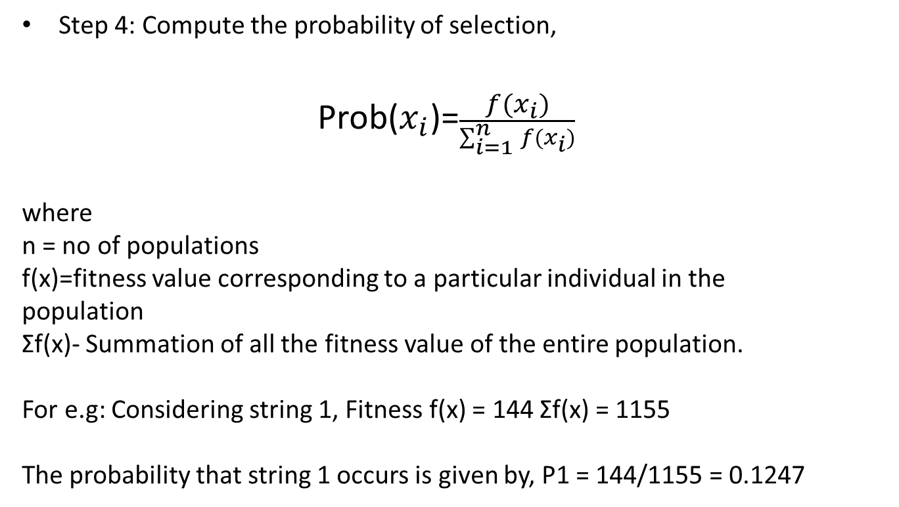
Step 4: Compute the probability of selection,
Prob($x_{i}$)=$\frac{f(x_{i})}{\sum_{i=1}^{n}{f(x_{i})}}$
where
n = no of populations
f(x)=fitness value corresponding to a particular individual in the
population
Σf(x)- Summation of all the fitness value of the entire population.
For e.g: Considering string 1, Fitness f(x) = 144 Σf(x) = 1155
The probability that string 1 occurs is given by, P1 = 144/1155 = 0.1247

Slide 9
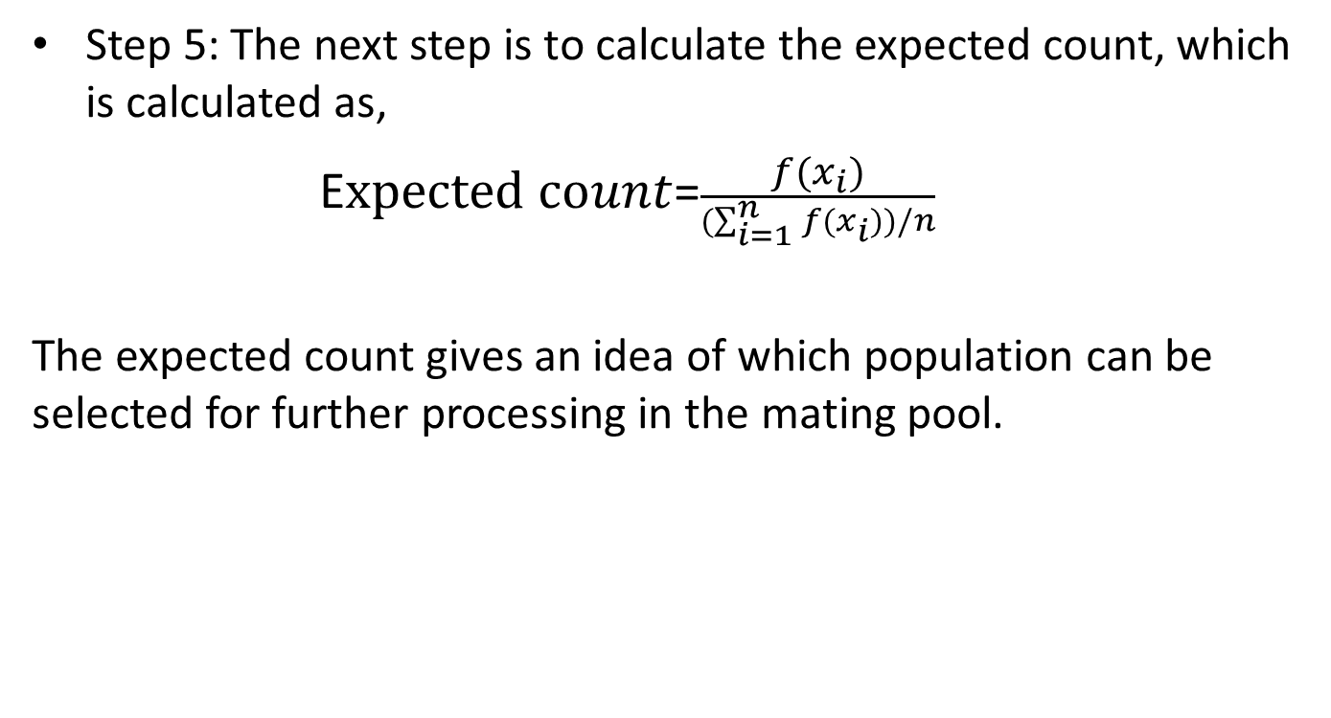
Step 5: The next step is to calculate the expected count, which is calculated as,
E$xpected count$=$\frac{f(x_{i})}{(\sum_{i=1}^{n}{f(x_{i}))/n}}$
The expected count gives an idea of which population can be selected for further processing in the mating pool.

Slide 11
Step 6: Now the actual count is to be obtained to select the individuals, which would participate in the crossover cycle using Roulette wheel selection:

Slide 12
actual count
String 1 occupies 12.47%, so there is a chance for it to occur at least once. Hence its actual count may be 1.
With string 2 occupying 54.11% of the Roulette wheel, it has a fair chance of being selected twice. Thus its actual count can be considered as 2.
On the other hand, string 3 has the least probability percentage of 2.16%, so their occurrence for next cycle is very poor. As a result, it actual count is 0.
String 4 with 31.26% has at least one chance for occurring while Roulette wheel is spun, thus its actual count is 1.

Slide 13
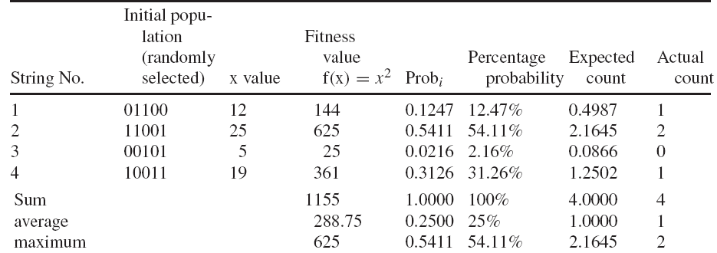

Slide 14
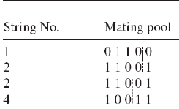
Step 7: Now, writing the mating pool based upon the actual count as shown in Table.
The actual count of string no 1 is 1, hence it occurs once in the mating pool.
The actual count of string no 2 is 2, hence it occurs twice in the mating pool.
Since the actual count of string no 3 is 0, it does not occur in the mating pool.
Similarly, the actual count of string no 4 being 1, it occurs once in the mating pool.
Based on this, the mating pool is formed.

Slide 15
Step 8: Crossover operation is performed to produce new offspring (children).
The crossover point is specified and based on the crossover point, single point crossover is performed and new offspring is produced.
Parent 1 0 1 1 0 0
Parent 2 1 1 0 0 1
The offspring is produced as,
Offspring 1 0 1 1 0 1
Offspring 2 1 1 0 0 0
Note: The crossover probability was assumed to 1.0

Slide 16
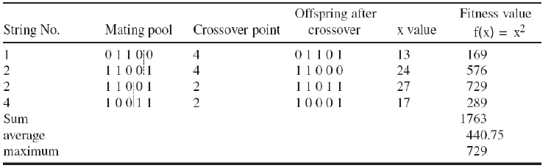

Slide 17
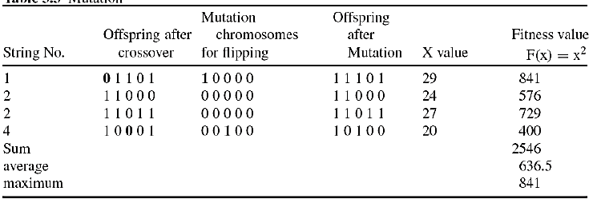
Step 9: After crossover operations, new off springs are produced and ‘x’ values are decodes and fitness is calculated.
Step 10: In this step, mutation operation is performed to produce new off springs after crossover operation.
In mutation-flipping operation is performed and new off springs are produced.
Note: The mutation probability was assumed to 0.001

Slide 18
Once the off springs are obtained after mutation, they are decoded to x value and find fitness values are computed.
This completes one generation.
The mutation is performed on a bit-bit by basis .

